Slide 1
JavaScript
Anil K

Slide 2
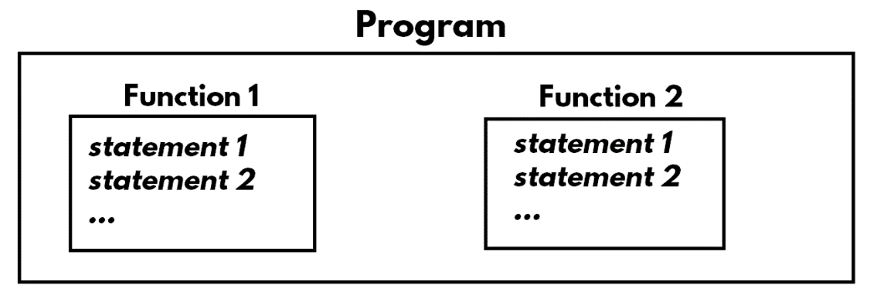
Function
Function is a re-usable “block” of the program, which is a set of statements with a name.
The large program can be divided into many parts; each individual part is called as “function”.
Functions are re-usable. That means functions can be called anywhere and any no. of times within the program. Every time when we call the function, the execution flow jumps to the function definition; executes the function and comes back to the calling portion.

Slide 3
Steps for development of functions
Create the function:
function functionname(parameter1, parameter2, ...)
{
code here
}
Parameters: The values that are passed from "calling portion" to the "function definition" are called as "arguments" and "parameters".
Return: The value that is passed from "function definition" to the "calling portion" is called as "return".
Call the function:
functionName(value1, value2, ...);
Access the list of arguments:
arguments
Note: Every function has a property called "arguments", which represents the list of arguments that are passed to the function. arguments ={0:argument1, 1: argument1, ...}

Slide 4
Simple Example on Functions
<html>
<head>
<title>functions</title>
</head>
<body>
<h1>functions</h1>
<script>
function country()
{
console.log("USA");
}
country();
</script>
</body>
</html>

Slide 5
Calling Function in Another Function - Example
<html>
<head>
<title>functions</title>
</head>
<body>
<h1> functions</h1>
<script>
function country()
{
console.log("USA");
city();
}
function city()
{
console.log("New York");
}
country();
</script>
</body>
</html>

Slide 6
Arguments and Return
<html>
<head>
<title>functions</title>
</head>
<body>
<h1>functions</h1>
<script>
function add(a, b)
{
var c; //local variable
c = a + b;
return (c);
}
var result;
result = add(10, 20);
console.log(result); //30
var x = 100;
var y = 250;
var result2 = add(x, y);
console.log(result2): //350
</script>
</body>
</html>

Slide 7
Arguments - Example
<html>
<head>
<title>Arguments</title>
</head>
<body>
<h1>Arguments</h1>
<script>
function fun1(a, b)
{
console.log(arguments);
}
fun1(10, 20);
fun1(10, 20, 30);
</script>
</body>
</html>

Slide 8
Recursion
Recursion is a technique of calling a function inside itself.
Whenever a function calls itself, it is said to be "recursion".
We should check the condition inside the function and call the same function, only if the condition is TRUE.
Example:
Factorial of number = n * n-1 * n-2 * n-3 … * 0
Factorial of 5 = 5 * 4 * 3 * 2 * 1 = 120
Syntax:
function functionname() {
samefunctionname();
}

Slide 9
Recursion - Example
<html>
<head>
<title>Recursion</title>
</head>
<body>
<h1>Recursion</h1>
<script>
function factorial(n)
{
if (n == 0)
{
return 1;
}
else
{
return n * factorial(n - 1);
}
}
console.log(factorial(6));
</script>
</body>
</html>

